Slide 1
A Tale of Two Shares: Why Two-Share Threshold Implementation Seems Worthwhile and Why it is Not
Cong Chen, Mohammad Farmani and Thomas Eisenbarth
Vernam Group at Worcester Polytechnic Institute, USA
ASIACRYPT 2016, Hanoi, Dec 8, 2016

Slide 2
Outline
Motivation and Background
Two-share TI masking
Implementation results
Leakage Analysis
Conclusion
Notes:
1.citations: TI, Consolidating, d+1 did not discuss 2nd order leakage
2.

Slide 3
Motivation
Tailored for constrained applications – Lightweight Cryptography.
Physical security, e.g., side-channel leakage resistance.
Efficient Implementations in terms of area and other costs.
Notes:
Change figures;

Slide 4
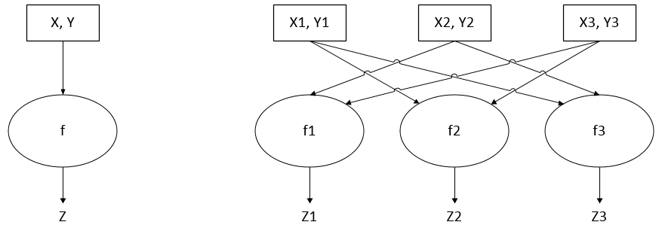
Threshold Implementation(TI)
Correctness; Non-completeness; Uniformity
Nikova, S., Rechberger, C., Rijmen, V.: Threshold implementations against side-channel attacks and glitches. ICICS 2006.

Slide 5
How many shares?
$$t×d+1$$
t: degree of nonlinearity; d: protection order
Reparaz, O., Bilgin, B., Nikova, S., Gierlichs, B., Verbauwhede, I.: Consolidating Masking Schemes. CRYPTO 2015
De Cnudde, T., Reparaz, O., Bilgin, B., Nikova, S., Nikov, V., Rijmen, V.: Masking AES with d + 1 Shares in Hardware. CHES 2016.
Hannes Gross and Stefan Mangard and Thomas Korak. Domain-Oriented Masking: Compact Masked Hardware Implementations with Arbitrary Protection Order. CARDIS 2016

Slide 6
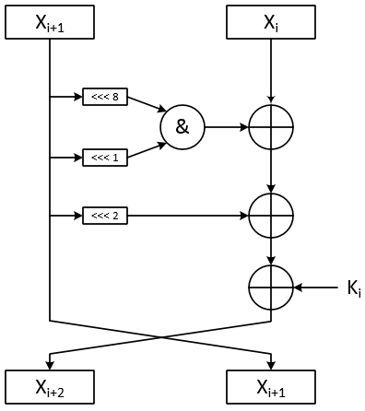
Simon
Interesting Features:
Optimized for hardware
Algebraic degree: 2
Fully bit-serializable
Notes:
Simple lightweight operation; fit bit-serialization; add texts to address those; algebraic depth

Slide 7
Outline
Motivation and Background
Two-share TI masking
Implementation results
Leakage Analysis
Conclusion

Slide 8
From 3-share to 2-share
Trivial for linear function:
$$z=a+b$$
Correct;
Non-Complete;
Uniform;

Slide 9
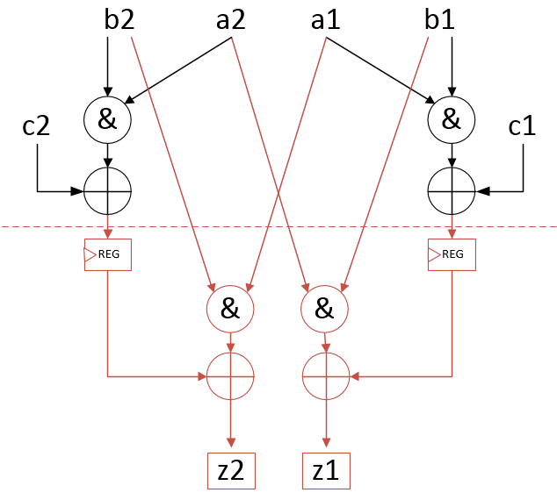
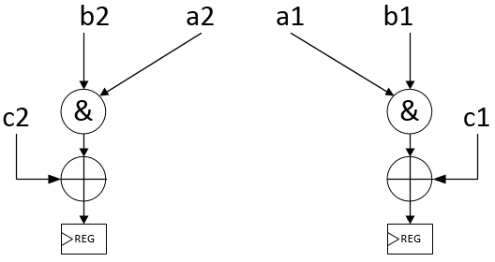
From 3-share to 2-share
Non-linear function:
$$z=a⋅b+c$$
$$z_{2}=(a_{2}⋅b_{2}+c_{2})+a_{1}⋅b_{2}$$
$$z_{1}=(a_{1}⋅b_{1}+c_{1})+a_{2}⋅b_{1}$$
Pipelining!
Correct;
Non-Complete;
Uniform;
Compared with 3-share:
Less randomness
Less logic operations
Two extra flip-flops
Two stages
Notes:
Try to visualize the pipelining of two shares; move down the two AND operation;using virtual regs

Slide 10
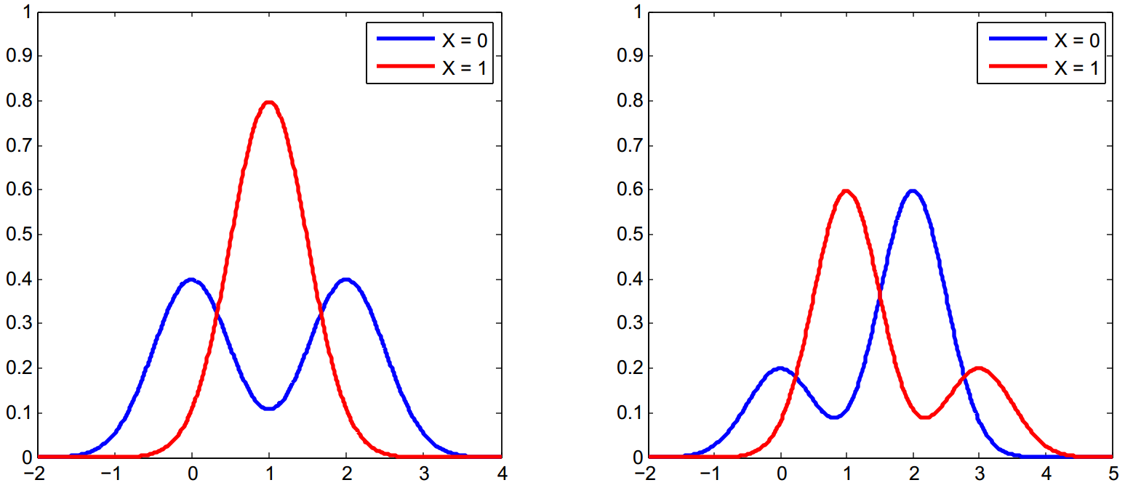
A potential pitfall
PDF for 2-share of 1 bit
PDF for 3-share of 1 bit
Same mean;
Different variance;
Same mean;
Same variance;
Notes:
Instead of using table, use simple texts; explain the equal mean and different variance in 2TI.

Slide 11
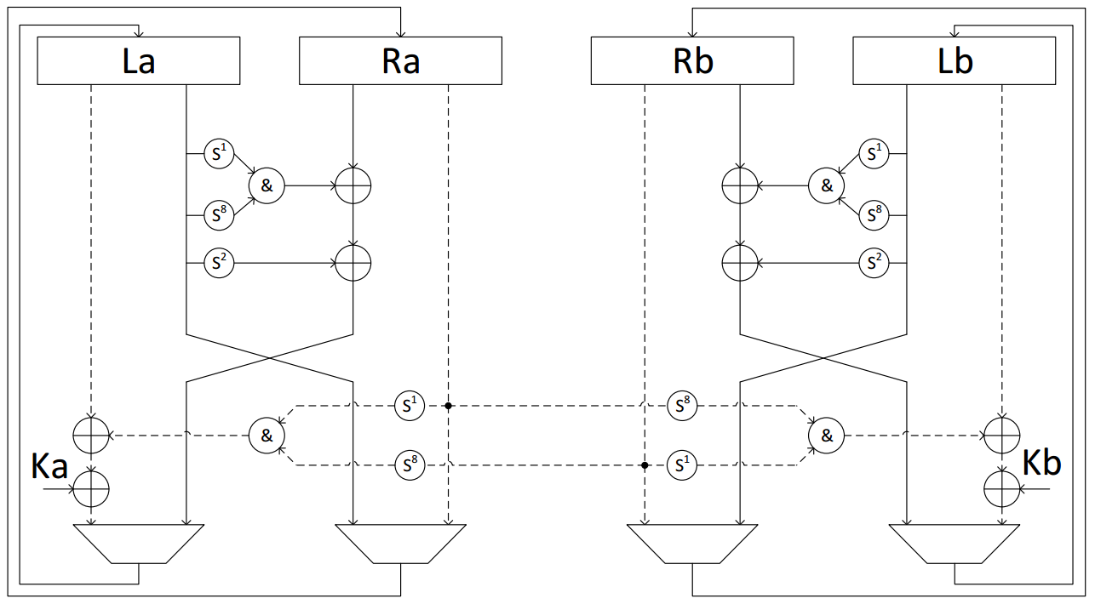
Application on Simon (round-based)
Two stages each round;
- Two clock cycles;
Correctness;
Non-completeness
Uniformity
Solid line: 1st clock cycle;
Dotted line: 2nd clock cycle

Slide 12
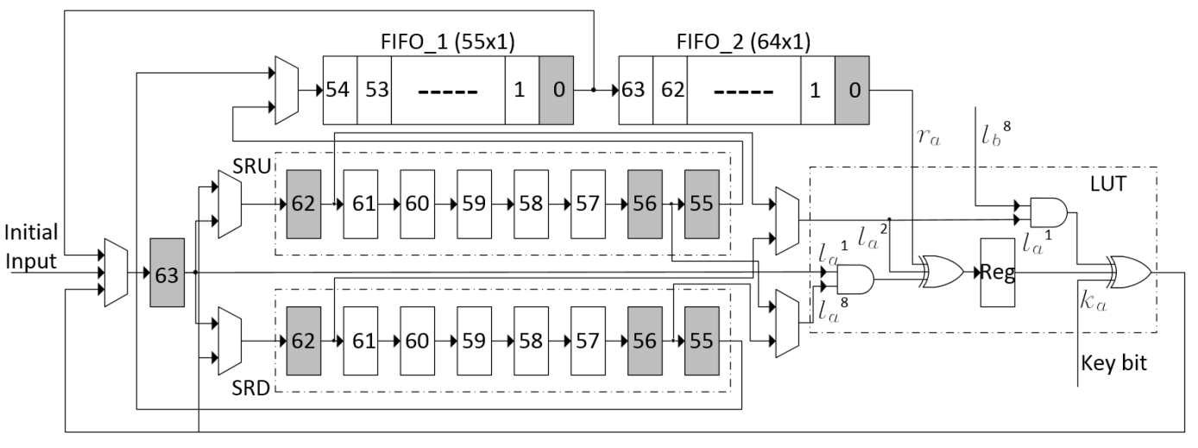
Application on Simon (bit-serialized)
Bit-serialized;
Pipelining;
Correctness;
Non-completeness
Uniformity
Poschmann, A., Moradi, A., Khoo, K., Lim, C.W., Wang, H., Ling, S.: SideChannel Resistant Crypto for less than 2,300 GE. Journal of Cryptology 24(2) 2011
Shahverdi, A., Taha, M., Eisenbarth, T.: Silent Simon: A Threshold Implementation under 100 Slices. HOST 2015.
Notes:
Too much detail in figure; mention previous works from VT as well

Slide 13
Outline
Motivation and Background
Two-share TI masking
Implementation results
Leakage Analysis
Conclusion

Slide 14
Slice Registers

Slide 15
Slice LUTs

Slide 16
Throughput (Mbps)
Notes:
Drop present; using percentage comparison to show how pipelines save performance;

Slide 17
Outline
Motivation and Background
Two-share TI masking
Implementation results
Leakage Analysis
Conclusion

Slide 18
Theoretical Analysis
2-TI Present Sbox as a target.
Hamming weight leakage model.
1st order and 2nd order analyses
T-test and CPA attack

Slide 19
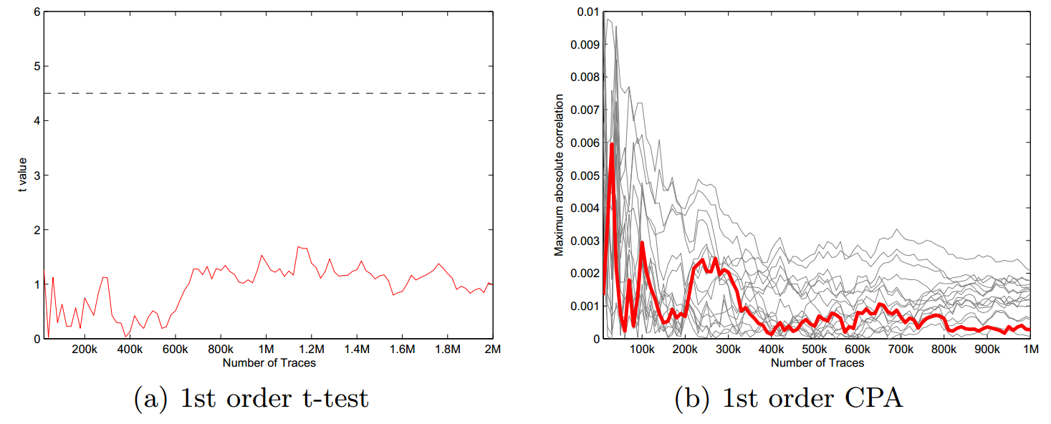
Theoretical Analysis
1st order analyses on Present Sbox

Slide 20
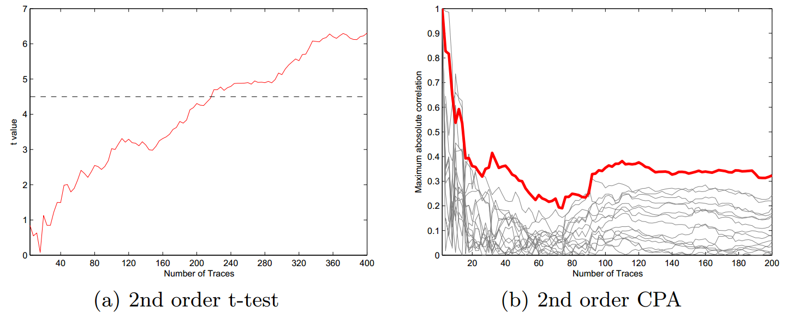
Theoretical Analysis
2nd order analyses on Present Sbox

Slide 21
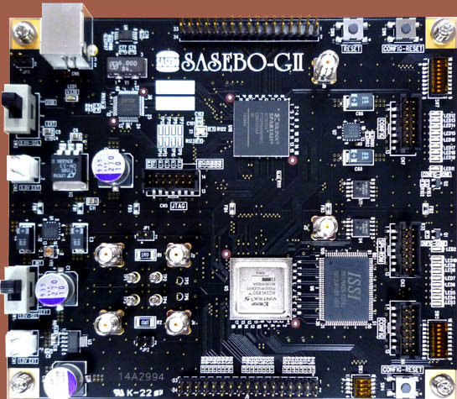
Practical Analysis
Targets: 2TI/3TI round-based Simon, 2TI Present
Platform: SASEBO-GII clocked at 3MHz;
Oscilloscope: Tektronix DPO; 100MS/sec;

Slide 22
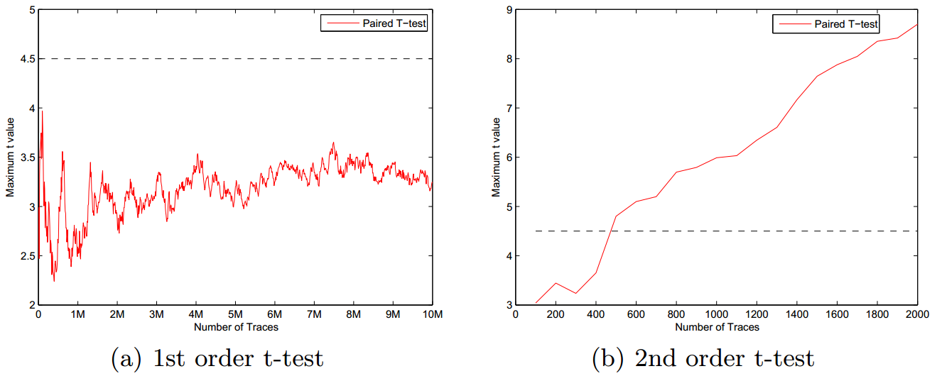
Analyses on Simon (2TI Round-based)
T-test analyses on 2TI Simon

Slide 23
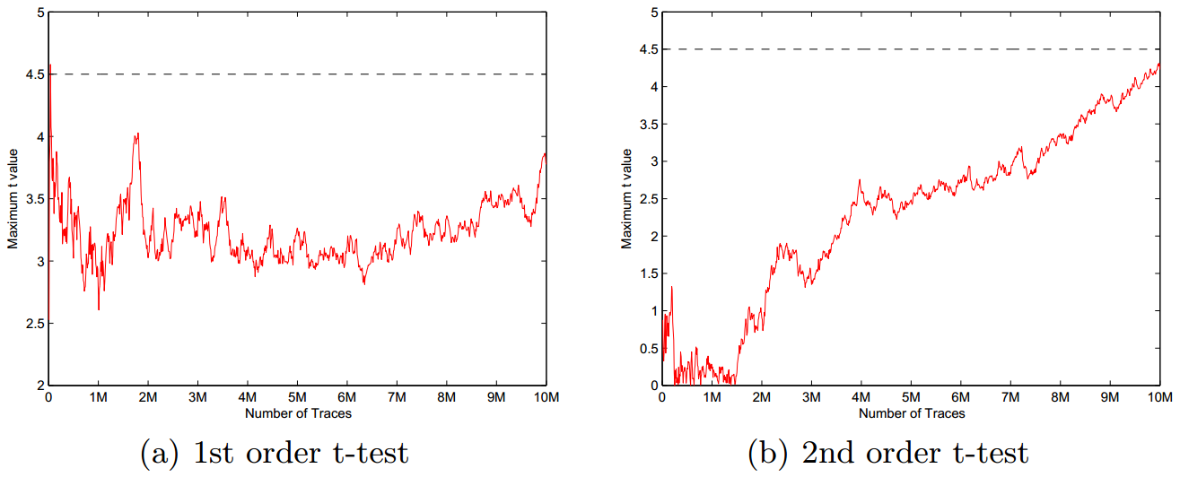
Analyses on Simon (3TI Round-based)
T-test analyses on 3TI Simon

Slide 24
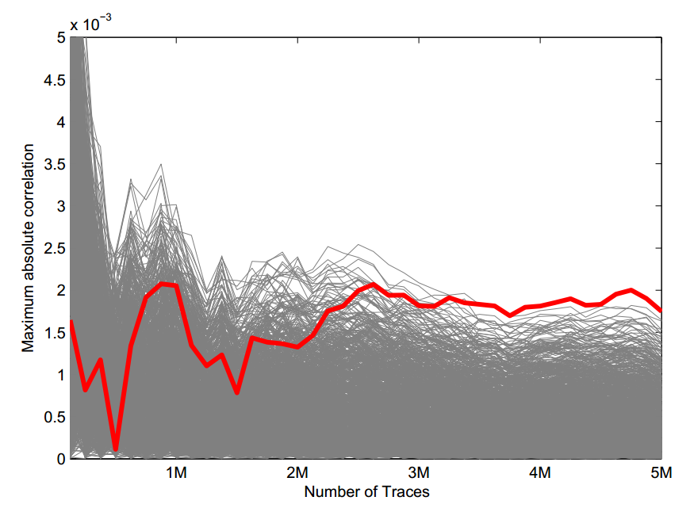
2nd order CPA on 2-TI Simon
Number of traces vs. Correlation Coefficient
Notes:
Present only; Mention profiled attack will improve

Slide 25
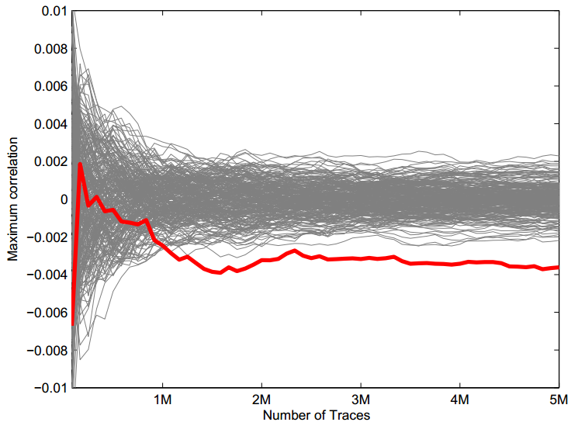
2nd order CPA on 2-TI Present
Number of traces vs. Correlation Coefficient
Notes:
Present only; Mention profiled attack will improve

Slide 26
Outline
Motivation and Background
Two-share TI masking
Implementation results
Leakage Analysis
Conclusion

Slide 27
Conclusion
Pipelining and Serilization.
- Reduced area and randomness.
- Maintained performance.
Fit for lightweight cryptography.
First order side-channel leakage resistance.
Strong second order leakage is observed in 2-TI.
Notes:
Discuss randomness reduction; fit for these cipher not for aes; delete provable; serilization and pipelining;

Slide 28
T
H
A
N
K
S

Slide 29
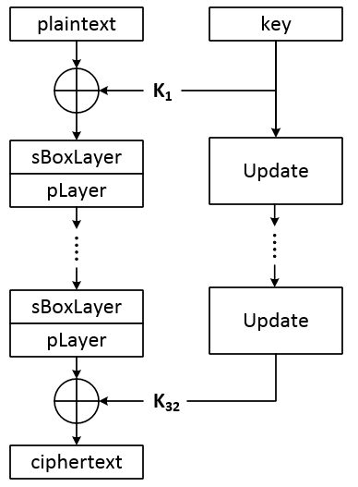
Present
Notes:
Small sbox; list facts relevant with our work

Slide 30
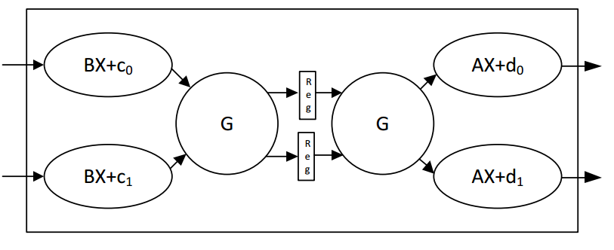
Application on Present
2-share datapath of Present Sbox

Slide 31
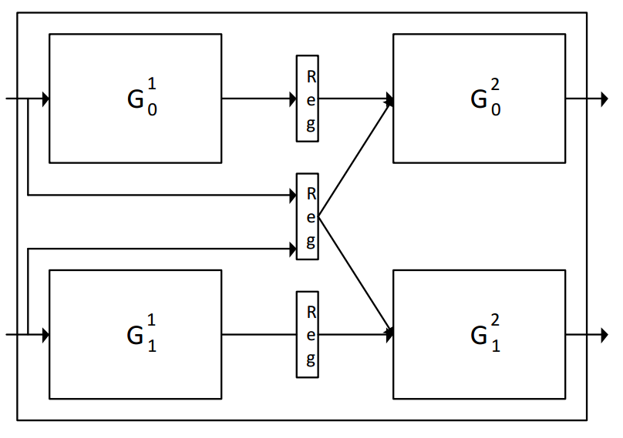
Application on Present
2-sharing of G function
Notes:
Delete simon

Slide 32
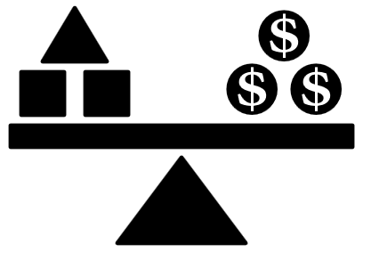
How many shares?
Area Performance
Randomness Security

