Slide 1
How to circumvent the two-ciphertext lower bound for linear garbling schemes
Carmen Kempka, Ryo Kikuchi, Koutarou Suzuki @NTT Corporation

Slide 2
Agenda
Lower bound and our result
Garbling single AND gate
Garbling multiple gates and other types
Efficiency comparison

Slide 3




Garbling scheme
Evaluate the circuit w/o knowing truth values
(plain) circuit
garbled circuit
$$K_{A}^{0},K_{A}^{1}$$
0,1
$$H\left(K_{A}^{0}||K_{B}^{0}\right)⊕K_{C}^{0}$$
$$H\left(K_{A}^{0}||K_{B}^{1}\right)⊕K_{C}^{0}$$
$$H\left(K_{A}^{1}||K_{B}^{0}\right)⊕K_{C}^{0}$$
$$H\left(K_{A}^{1}||K_{B}^{1}\right)⊕K_{C}^{1}$$
AND
0,1
$$K_{C}^{0},K_{C}^{1}$$
0,1
$$K_{B}^{0},K_{B}^{1}$$
Notes:
Ok, Let’s get started by introducing garbling scheme.
Garbling scheme is a mechanism to evaluate circuit w/o knowing truth values.
For example, we show how to gable single AND gate.
Each truth values are encoded to the keys. This 0 and 1 is encoded to K_A^0 and K_A^1, and so on.
In this example, garbled AND gate contains 4 ciphertexts.
The output keys are encrypted with two input keys.
If we want to evaluate 0 AND 1 euqals to 0,
the input is K_A^0 and K_B^1, and decrypts the second ciphertext that contain K_C^0.

Slide 4



Garbling scheme
Evaluate the circuit w/o knowing truth values
(plain) circuit
garbled circuit
$$K_{A}^{0}$$
0
$$H\left(K_{A}^{0}||K_{B}^{0}\right)⊕K_{C}^{0}$$
$$H\left(K_{A}^{0}||K_{B}^{1}\right)⊕K_{C}^{0}$$
$$H\left(K_{A}^{1}||K_{B}^{0}\right)⊕K_{C}^{0}$$
$$H\left(K_{A}^{1}||K_{B}^{1}\right)⊕K_{C}^{1}$$
AND
0
$$K_{C}^{0}$$
1
$$K_{B}^{1}$$
Notes:
Ok, Let’s get started by introducing garbling scheme.
Garbling scheme is a mechanism to evaluate circuit w/o knowing truth values.
For example, we show how to gable single AND gate.
The left side is a plain AND gate, and the right side is the garbled AND gate with classical technique.
Each truth values are encoded to the keys. This 0 and 1 is encoded to K_A^0 and K_A^1, and so on.
In this example, garbled AND gate contains 4 ciphertexts.
The output keys are encrypted with two input keys.
If we want to evaluate 0 AND 1 euqals to 0,
the input is K_A^0 and K_B^1, and decrypts the second ciphertext that contain K_C^0.

Slide 5




Reducing the size of garbled circuit
k-bit element
Classical [Yao86]:
$$K_{A}^{0},K_{A}^{1}$$
$$H\left(K_{A}^{0}||K_{B}^{0}\right)⊕K_{C}^{0}$$
$$H\left(K_{A}^{0}||K_{B}^{1}\right)⊕K_{C}^{0}$$
$$H\left(K_{A}^{1}||K_{B}^{0}\right)⊕K_{C}^{0}$$
$$H\left(K_{A}^{1}||K_{B}^{1}\right)⊕K_{C}^{1}$$
$$K_{C}^{0},K_{C}^{1}$$
$$K_{B}^{0},K_{B}^{1}$$
Technique | Size per AND gate | Size per XOR gate
Classical [Yao86] | 4k
GRR3 [NPS99] | 3k
GRR2 [PSSW09] | 2k
Free-XOR [KS08]+GRR3 | 3k | 0
fleXOR [KMR14] | 2k | {0,1,2}k
Half gates [ZRE15] | 2k | 0
Notes:
In the classical result by Yao, shown in the previous slide, each gate requires 4 ciph’s and each ciph’ is k-bit where k is the security parameter.
So, the classical garbling scheme requires 4 times k-bit per any gate.
There have been several studies to reduce the size of garbled circuit.
GRR3, GRR2, Free XOR, fleXOR, and half gates.
The most efficient garlbing scheme is half gate.
It requires 2k bit per AND gate and 0 bit per XOR gate.

Slide 6
Linear garbling scheme and lower bound [ZRE15]
A linear garbling scheme captures all practically efficient garbling schemes
The lower bound says
  a linear garbling scheme must have two k-bit ciphertexts per AND gate
Half gates achieves the bound
Half-gates seems to be optimal
Notes:
In addition to propose half gate scheme, Zahur et al. shows the lower bound of the size of garbled circuit.
Roughly speaking, a linear garbling scheme is that the output keys are defined as a linear combination of random or hashed values.
The lower bound says that a linear garbling scheme must have at least two k-bit ciphertext per AND gate.
Half gate schemes achieves this lower bound so half gate scheme is to be optimal in respect of the size of garbled circuit.

Slide 7
Our result
We propose a “linear” garbling scheme
  requires strictly less than two k-bit ciphertexts per AND gate
The scheme does not contradict but rather circumvents the lower bound
  Proof of the lower bound assumes each ciphertext is k-bit
  Our scheme requires one k-bit and four 2-bit ciphertexts per AND gate
    Five cipertexts in total
Notes:
However, in the paper, we propose a linear garbling scheme
requires strictly less than two k-bit ciphertexts per AND gate.
You may think that this result is a contradiction.
However, we think that this result does not contradicts but rather circumvents the lower bound because,
Proof of lower bound assumes that each ciphertext is k-bit
Our scheme requires one k-bit and four 2-bit ciphertexts per AND gate

Slide 8
Agenda
Lower bound and our result
Garbling single AND gate
Garbling multiple gates and other types
Efficiency comparison
Notes:
Next we explain how to garble single AND gate.

Slide 9

Observation
k-bit element can be regarded as an element in not only $GF\left(2^{k}\right)$ but also $Z_{2^{k}}$
  Operation in $GF\left(2^{k}\right)$ is bit-wise XOR
    $0011⊕0011=0000$
  Operation in $Z_{2^{k}}$ is integer addition
    $0011+0011=0110$
Notes:
Before giving precise description, I’d like to share one basic observation.
In garbling scheme, we often use k-bit elements as a key and ciphertext.
This k-bit element can be regarded as an element in not only GF(2^k) but also Z_2^k. In other words, a bit-string or integer.
An operation in GF(2^k) is bit-wise XOR. For example, 0011 oplus 0011 equals to 0000.
On the other hand, operation in Z_{2^k} is integer addition.
For example, 0011 + 0011 equals to 0110, which is different from the other.
What we want to say in this slide is we can use two operations on k-bit elements.

Slide 10





Setting
Trying to gable single AND gate with single k-bit ciphertext $G$
Operations consist of $H\left(⋅\right)$, $+$, and $⊕$
(plain) circuit
garbled circuit
$$K_{A}^{0},K_{A}^{1}$$
0,1
AND
0,1
$$K_{C}^{0},K_{C}^{1}$$
0,1
$$K_{B}^{0},K_{B}^{1}$$
$$G$$
Notes:
To explain an idea of construction, let’s consider garbling single AND gate with single k-bit ciphertext G.
Namely, we assume that garbled AND gate contains only G.
In addition, for efficiency, we use hash function, +, and oplus.

Slide 11











Evaluation on garbled AND gate
Input
Evaluation
Output
$$K_{A}^{0}, K_{B}^{0}$$
Eval($K_{A}^{0},K_{B}^{0},G$)
$$K_{A}^{0}, K_{B}^{1}$$
Eval($K_{A}^{0},K_{B}^{1},G$)
$$K_{C}^{0}$$
$$K_{A}^{1}, K_{B}^{0}$$
Eval($K_{A}^{1},K_{B}^{0},G$)
$$K_{A}^{1}, K_{B}^{1}$$
Eval($K_{A}^{1},K_{B}^{1},G$)
$$H(K_{0}^{A}+K_{1}^{B})$$
$$K_{C}^{1}$$
Notes:
I explain how to garble AND gate step by step.
We show an illustration of evaluation and define the keys and procedure.
There are four cases of the input keys. 0 0, 01, 10, and 11.
For each case, one evaluates the output key with the input keys and ciphertext G, and finally obtains the output key.
Because it is AND gate, three of four input keys should be mapped to 0 key,
and only the case where input is 11 should be mapped to 1 key.

Slide 12
Evaluation on garbled AND gate
Define the input/output keys and Eval() satisfying this!
Input
Evaluation
Output
$$K_{A}^{0}, K_{B}^{0}$$
Eval($K_{A}^{0},K_{B}^{0},G$)
$$K_{A}^{0}, K_{B}^{1}$$
Eval($K_{A}^{0},K_{B}^{1},G$)
$$K_{C}^{0}$$
$$K_{A}^{1}, K_{B}^{0}$$
Eval($K_{A}^{1},K_{B}^{0},G$)
$$K_{A}^{1}, K_{B}^{1}$$
Eval($K_{A}^{1},K_{B}^{1},G$)
$$K_{C}^{1}$$
Notes:
First, we try to define the input/output keys and Evaluation function
so that the mapping is correct.

Slide 13

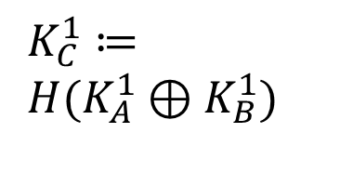

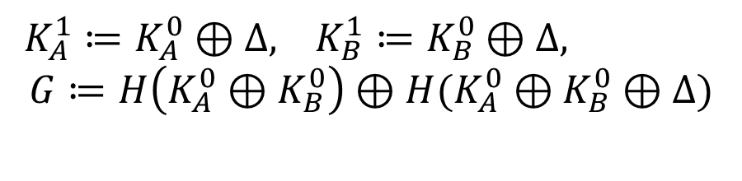


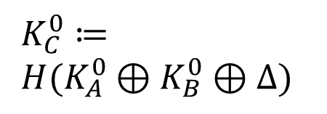
Idea 1: Free-XOR-like definition
$K_{A}^{1}≔K_{A}^{0}⊕Δ, K_{B}^{1}≔K_{B}^{0}⊕Δ,$
$$G≔H\left(K_{A}^{0}⊕K_{B}^{0}\right)⊕H(K_{A}^{0}⊕K_{B}^{0}⊕Δ)$$
Input
Evaluation
Output
$$K_{A}^{0}, K_{B}^{0}$$
$$H\left(K_{A}^{0}⊕K_{B}^{0}\right)⊕G$$
$$K_{A}^{0}, K_{B}^{1}$$
$$H\left(K_{A}^{0}⊕K_{B}^{1}\right)$$
$K_{C}^{0}≔$
$H(K_{A}^{0}⊕K_{B}^{0}⊕Δ)$
$$K_{A}^{1}, K_{B}^{0}$$
$$H\left(K_{A}^{1}⊕K_{B}^{0}\right)$$
$K_{C}^{1}≔$
$H(K_{A}^{1}⊕K_{B}^{1})$
$$K_{A}^{1}, K_{B}^{1}$$
$$H\left(K_{A}^{1}⊕K_{B}^{1}\right)$$
Notes:
First idea is using Free-XOR-like definition.
1 key defined as K_0 \oplus Delta, and evaluation is hashing.
If so, the second case and third case mapped to the same value
since K_A^0 \oplus K_B^1 = K_A^1 \oplus K_B^0.
In addition, we use G to adjust the output. The fist case is also mapped to the 0 keys since the hash value is canceled.
Therefore, for now, this map is satisfied.

Slide 14
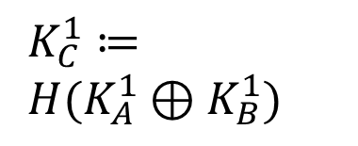
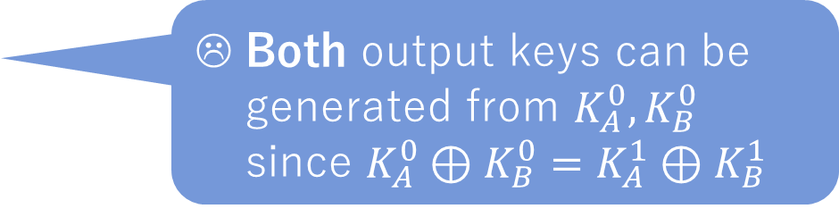
Idea 1: Free-XOR-like definition
Both output keys can be generated from $K_{A}^{0},K_{B}^{0}$ since $K_{A}^{0}⊕K_{B}^{0}=K_{A}^{1}⊕K_{B}^{1}$
$K_{A}^{1}≔K_{A}^{0}⊕Δ, K_{B}^{1}≔K_{B}^{0}⊕Δ,$
$$G≔H\left(K_{A}^{0}⊕K_{B}^{0}\right)⊕H(K_{A}^{0}⊕K_{B}^{0}⊕Δ)$$
Input
Evaluation
Output
$$K_{A}^{0}, K_{B}^{0}$$
$$H\left(K_{A}^{0}⊕K_{B}^{0}\right)⊕G$$
$$K_{A}^{0}, K_{B}^{1}$$
$$H\left(K_{A}^{0}⊕K_{B}^{1}\right)$$
$K_{C}^{0}≔$
$H(K_{A}^{0}⊕K_{B}^{0}⊕Δ)$
$$K_{A}^{1}, K_{B}^{0}$$
$$H\left(K_{A}^{1}⊕K_{B}^{0}\right)$$
$K_{C}^{1}≔$
$H(K_{A}^{1}⊕K_{B}^{1})$
$$K_{A}^{1}, K_{B}^{1}$$
$$H\left(K_{A}^{1}⊕K_{B}^{1}\right)$$
Notes:
However, this evaluation is clearly insecure because,
from K_A^0 and K_B^0, both output keys can be generated since $K_{A}^{0}⊕K_{B}^{0}=K_{A}^{1}⊕K_{B}^{1}$

Slide 15


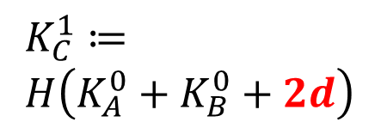
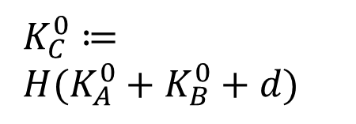


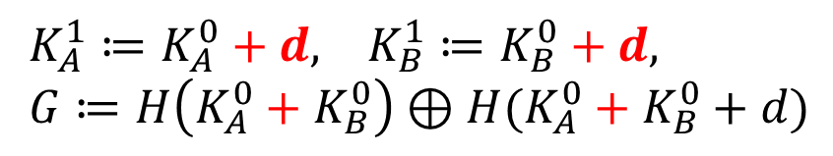

Idea 2: Use $+$ instead of $⊕$ in hash
$K_{A}^{1}≔K_{A}^{0}+d, K_{B}^{1}≔K_{B}^{0}+d,$
$G≔H\left(K_{A}^{0}+K_{B}^{0}\right)⊕H(K_{A}^{0}+K_{B}^{0}+d)$
Input
Evaluation
Output
$$K_{A}^{0}, K_{B}^{0}$$
$$H\left(K_{A}^{0}+K_{B}^{0}\right)⊕G$$
$$K_{A}^{0}, K_{B}^{1}$$
$$H\left(K_{A}^{0}+K_{B}^{1}\right)$$
$K_{C}^{0}≔$
$H(K_{A}^{0}+K_{B}^{0}+d)$
$$K_{A}^{1}, K_{B}^{0}$$
$$H\left(K_{A}^{1}+K_{B}^{0}\right)$$
$K_{C}^{1}≔$
$H\left(K_{A}^{0}+K_{B}^{0}+2d\right)$
$$K_{A}^{1}, K_{B}^{1}$$
$$H\left(K_{A}^{1}+K_{B}^{1}\right)$$
Notes:
To avoid this security problem, we use integer addition instead of oplus in hashing.
We re-define 1 key as 0 keys + d, and we use + instead of oplus in the hash.
Then, K_C^1 becomes the hash of K_A^0 + K_B^0 + 2d, which cannot be derived from K_A^0 and K_B^0.
So the previous problem is avoided.

Slide 16

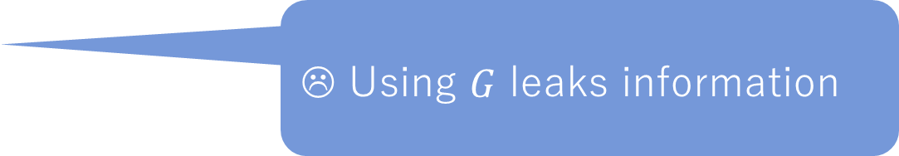
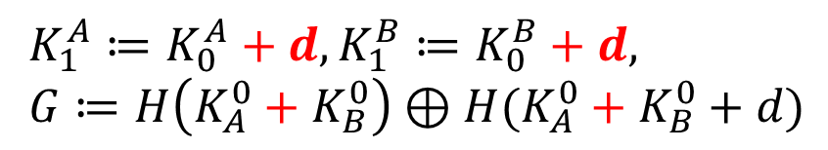
Idea 2: Use $+$ instead of $⊕$ in hashing
☹ Using $G$ leaks information
$K_{1}^{A}≔K_{0}^{A}+d, K_{1}^{B}≔K_{0}^{B}+d,$
$G≔H\left(K_{A}^{0}+K_{B}^{0}\right)⊕H(K_{A}^{0}+K_{B}^{0}+d)$
Input
Evaluation
Output
$$K_{A}^{0}, K_{B}^{0}$$
$$H\left(K_{A}^{0}+K_{B}^{0}\right)⊕G$$
$$K_{A}^{0}, K_{B}^{1}$$
$$H\left(K_{A}^{0}+K_{B}^{1}\right)$$
$K_{C}^{0}≔$
$H(K_{A}^{0}+K_{B}^{0}+d)$
$$K_{A}^{1}, K_{B}^{0}$$
$$H\left(K_{A}^{1}+K_{B}^{0}\right)$$
$K_{C}^{1}≔$
$H\left(K_{A}^{0}+K_{B}^{0}+2d\right)$
$$K_{A}^{1}, K_{B}^{1}$$
$$H\left(K_{A}^{1}+K_{B}^{1}\right)$$
Notes:
However, this still be insecure because G is used in only the first case.
If G is used, it means that the input is 00.
So, we should unify the evaluation procedure in all the cases.

Slide 17
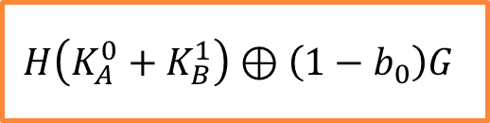

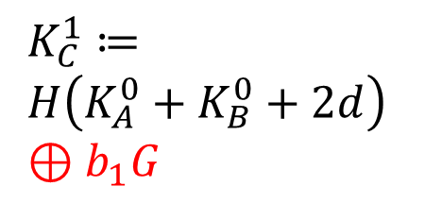
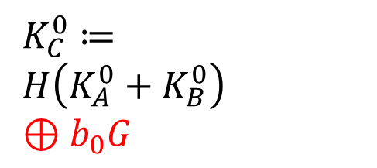
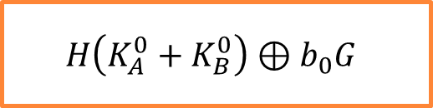
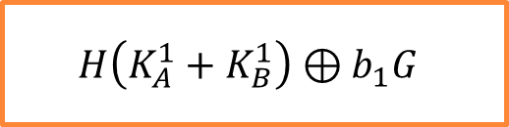
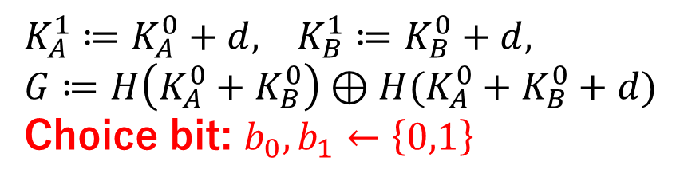
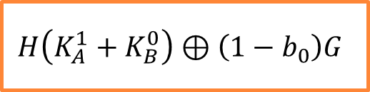
Idea 3: Use $G$ with probability 1/2
$K_{A}^{1}≔K_{A}^{0}+d, K_{B}^{1}≔K_{B}^{0}+d,$
$G≔H\left(K_{A}^{0}+K_{B}^{0}\right)⊕H(K_{A}^{0}+K_{B}^{0}+d)$
Choice bit: $b_{0},b_{1}←\left\{0,1\right\}$
☹ Choice bit of another case should be kept secret
Input
Evaluation
Output
$$K_{A}^{0}, K_{B}^{0}$$
$$H\left(K_{A}^{0}+K_{B}^{0}\right)⊕b_{0}G$$
$$K_{A}^{0}, K_{B}^{1}$$
$$H\left(K_{A}^{0}+K_{B}^{1}\right)⊕\left(1−b_{0}\right)G$$
$K_{C}^{0}≔$
$H\left(K_{A}^{0}+K_{B}^{0}\right)$
$⊕b_{0}G$
$$K_{A}^{1}, K_{B}^{0}$$
$$H\left(K_{A}^{1}+K_{B}^{0}\right)⊕\left(1−b_{0}\right)G$$
$K_{C}^{1}≔$
$H\left(K_{A}^{0}+K_{B}^{0}+2d\right)$
$⊕b_{1}G$
$$K_{A}^{1}, K_{B}^{1}$$
$$H\left(K_{A}^{1}+K_{B}^{1}\right)⊕b_{1}G$$
Notes:
Idea 3 is using G in every cases with probability half.
We add another two bits b_0 and b_1 we call as choice bits.
Output keys depend on the choice bits.
This construction, in each case evaluation consist of the same steps.
Add the input key, Hash that, and oplus G with probability half.
So, evaluation step does not leak the input value.
At this point, the garbling scheme is almost secure except b_0 and b_1

Slide 18


Idea 4: Garbling $b_{0}$ and $b_{1}$ by classical technique
Classical garbling scheme requires four ciphertexts
Each of them is not k-bit but 2-bit
  Each ciphetext contains $b_{i}$ (and permute bit $λ$)
Notes:
We have shown garbling scheme except b_0 and b_1.
We encrypt b_0 and b_1 as classical garbling scheme with permutation.
Namely, we add four ciphertexts that are 2 bit.
For security reason,
the order of the ciphertexts should be permuted so we add permute bit $λ$ in addition to the keys.
Input is the keys and permute bit,
and garbled gate contains G and four 2-bit ciphertexts, and the output is the key and next permute bit.

Slide 19
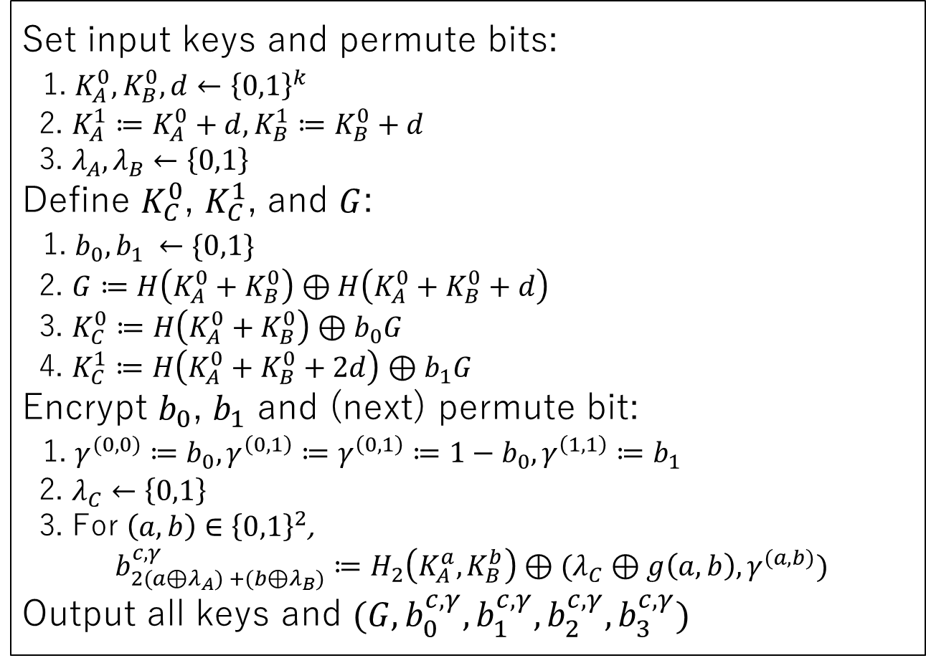
Garbling algorithm for single AND gate
Set input keys and permute bits:
1. $K_{A}^{0},K_{B}^{0},d←{\left\{0,1\right\}}^{k}$
2. $K_{A}^{1}≔K_{A}^{0}+d, K_{B}^{1}≔K_{B}^{0}+d$
3. $λ_{A},λ_{B}←\left\{0,1\right\}$
Define $K_{C}^{0}$, $K_{C}^{1}$, and $G$:
1. $b_{0},b_{1} ←\{0,1\}$
2. $G≔H\left(K_{A}^{0}+K_{B}^{0}\right)⊕H\left(K_{A}^{0}+K_{B}^{0}+d\right)$
3. $K_{C}^{0}≔H\left(K_{A}^{0}+K_{B}^{0}\right)⊕b_{0}G$
4. $K_{C}^{1}≔H\left(K_{A}^{0}+K_{B}^{0}+2d\right)⊕b_{1}G$
Encrypt $b_{0}$, $b_{1}$ and (next) permute bit:
1. $γ^{(0,0)}≔b_{0},γ^{\left(0,1\right)}≔γ^{\left(0,1\right)}≔1−b_{0},γ^{\left(1,1\right)}≔b_{1}$
2. $λ_{C}←\left\{0,1\right\}$
3. For $\left(a,b\right)∈{\left\{0,1\right\}}^{2}$,
$$b_{2(a⊕λ_{A}) +(b⊕λ_{B})}^{c,γ}≔H_{2}\left(K_{A}^{a},K_{B}^{b}\right)⊕(λ_{C}⊕g\left(a,b\right),γ^{(a,b)})$$
Output all keys and $(G,b_{0}^{c,γ},b_{1}^{c,γ},b_{2}^{c,γ},b_{3}^{c,γ})$
Notes:
Here is the resultant garbling algorithm for single AND gate.
First, set input keys as this and set the output keys and ciphertexts G as this.
Finally, encrypt b_0, b_1, and next permute bit
and obtain ciphertext b to c, gamma.
The output is input and output keys and 5 ciphertexts, which consists of two-bit
part and k bit part.

Slide 20
Agenda
Lower bound and our result
Garbling single AND gate
Garbling multiple gates and other types
Efficiency comparison

Slide 21
Handling multiple gates
AND
AND
AND
AND
AND
Notes:
Next we briefly explain how to garble multiple AND gates.

Slide 22

Handling multiple gates
For input AND gates
  We can choose $d$
  -> Single k-bit ciphertext per AND gates
AND
AND
AND
AND
AND
Notes:
Input AND gate is at least one of input wire is an input wire.
In this circuit, this, this, and this.
For input AND gate, we can choose difference d
so our garbling scheme can be applied directly, and

Slide 23

Handling multiple gates
For input AND gates
  We can choose $d$ and apply as single AND gate
  -> one k-bit ciphertext per input AND gate
1
1
AND
AND
1
Notes:
garbled gate contains single k-bit ciphertext.

Slide 24

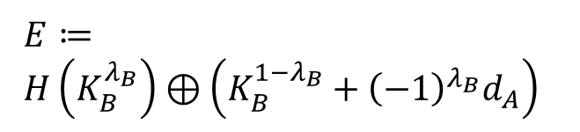


Handling multiple gates
For mid AND gates
  We cannot choose $d≔K_{previous}^{1}−K_{previous}^{0}$
  We adjust $d_{B}$ to $d_{A}$ using another ciphertext $E$
  -> Two k-bit ciphertexts per mid AND gate
1
$$d_{A}$$
1
AND
$$d_{B}$$
AND
$E≔$
$H\left(K_{B}^{λ_{B}}\right)⊕\left(K_{B}^{1−λ_{B}}+{\left(−1\right)}^{λ_{B}}d_{A}\right)$
1
Notes:
On the other hand, in the other AND gates we call mid AND gate,
we cannot choose difference d because d is already defined by the input keys.
To apply our garbling technique, we should adjust one difference d to the other,
and it requires one k-bit ciphertext E per gate.
Therefore,

Slide 25
Handling multiple gates
For mid AND gates
  We cannot choose $d≔K_{previous}^{1}−K_{previous}^{0}$
  We adjust $d_{B}$ to $d_{A}$ using another ciphertext $E$
  -> Two k-bit ciphertexts per mid AND gate
1
$$d_{A}$$
1
2
2
$$d_{B}$$
$E≔$
$H\left(K_{B}^{λ_{B}}\right)⊕\left(K_{B}^{1−λ_{B}}+{\left(−1\right)}^{λ_{B}}d_{A}\right)$
1
Notes:
each garbled gate contains two k-bit ciphertexts.

Slide 26
Garbling other types of gate
OR, XOR, NAND, and other standard gates can be garbled in a similar way
We can further reduce the ciphertext when garbling an XOR gate:
  No ciphertext per input XOR gate
  Single k-bit ciphertext per mid XOR gate

Slide 27
Security
Simulation-based privacy [BHR12]
  proved in the random oracle model
A variant of correlation robustness is sufficient but complicated and artificial
Notes:
Our garbling scheme acieves simulation-based privacy defined by Bellare, Huang, and Rogaway.
I do not give a precise description since the assumption is a bit complicated.
The assumption states that hash functions looks randomly,
and holds in the random oracle model.

Slide 28
Agenda
Lower bound and our result
Garbling single AND gate
Garbling multiple gates and other types
Efficiency comparison

Slide 29
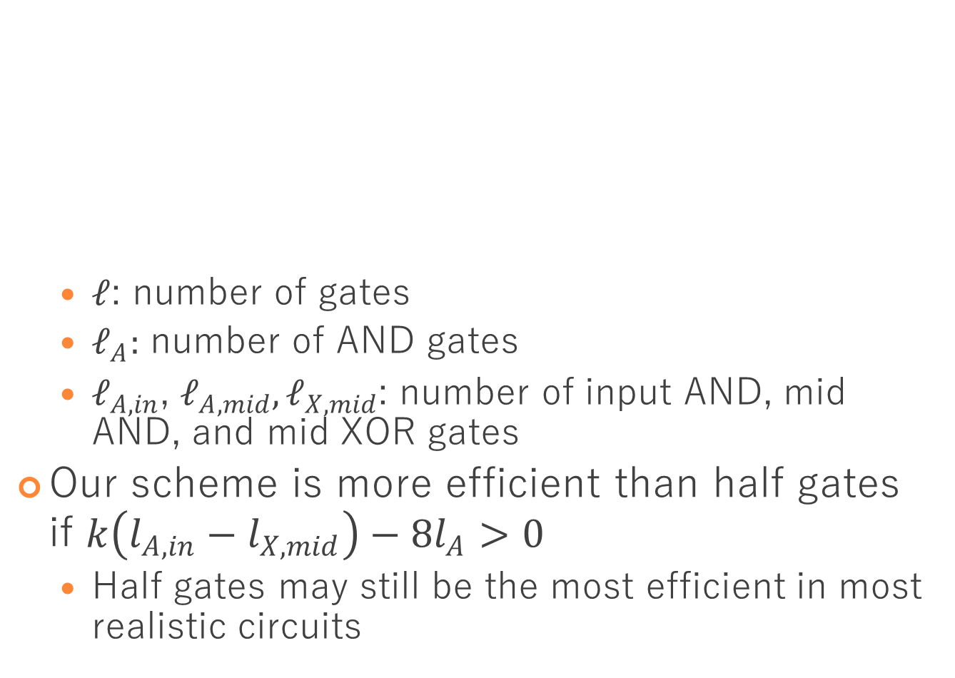
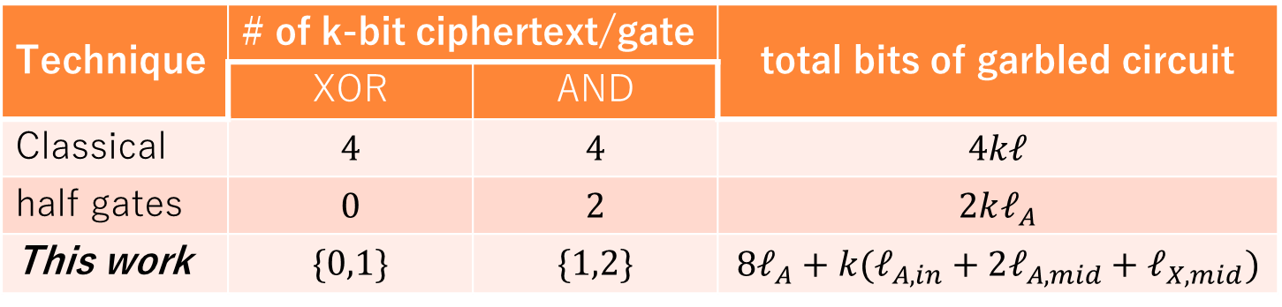
Comparison (in plain setting)
  $ℓ$: number of gates
  $ℓ_{A}:$ number of AND gates
  $ℓ_{A,in}$, $ℓ_{A,mid},ℓ_{X,mid}$: number of input AND, mid AND, and mid XOR gates
Our scheme is more efficient than half gates if $k\left(l_{A,in}−l_{X,mid}\right)−8l_{A}>0$
  Half gates may still be the most efficient in most realistic circuits
Technique | # of k-bit ciphertext/gate |  | total bits of garbled circuit
 | XOR | AND
Classical | $$4$$ | $$4$$ | $$4kℓ$$
half gates | $$0$$ | $$2$$ | $$2kℓ_{A}$$
This work | $$\{0,1\}$$ | $$\{1,2\}$$ | $$8ℓ_{A}+k(ℓ_{A,in}+2ℓ_{A,mid}+ℓ_{X,mid})$$
Notes:
Here is the comparison in respect of the size of garbled circuit.
We consider the plane setting that means the type of gate is public.
Classical scheme requires 4 k-bit ciphertexts per gate.
Half gates requires no ciphertext per XOR and 2 ciphertexts per AND gate, and the total is 2 times k+1 times L_A,
where L_A denotes the number of AND gates.
Our scheme requires 0 or 1 k-bit ciphertext per XOR and 1 or 2 k-bit ciphertext per AND gate.
The total is as this. the left side denotes 2-bit part, and the right side denotes the k-bit part.
As a result, our scheme is more efficient than half gates if the equation holds.
It means that number of input AND gates is larger than the number of mid XOR gates.
We think that in most realistic circuits, it does not hold and half gates may still be the best.

Slide 30
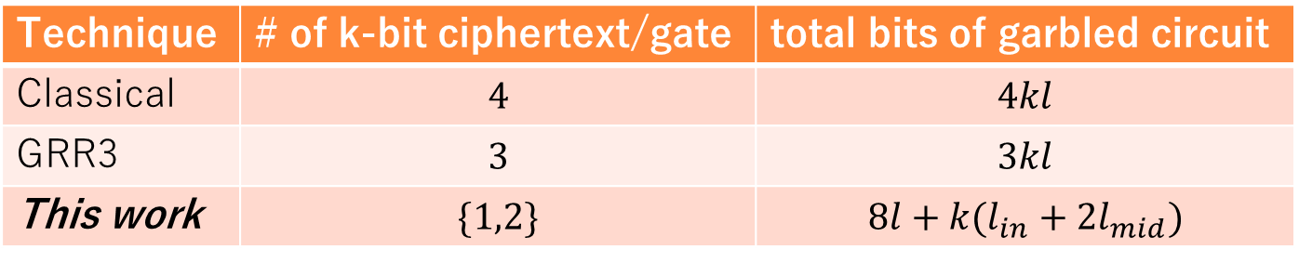
Comparison in semi-private function (SPF) setting
SPF hides the type of gates:
  Only circuit topology is public
NOTE: An identity gate cannot be garbled in this work
Technique | # of k-bit ciphertext/gate | total bits of garbled circuit
Classical | $$4$$ | $$4kl$$
GRR3 | $$3$$ | $$3kl$$
This work | $$\{1,2\}$$ | $$8l+k(l_{in}+2l_{mid})$$
Notes:
On the other hand, our scheme can be applied to semi-private function setting.
Semi-private function hides the type of gates, and only circuit topology is public.
There are three garbling schemes available in this setting.
As shown in the table, our scheme is the most efficient.
We note that our scheme cannot garble an identity gate in spite of the other scheme can.

Slide 31
Summary
We show a garbling scheme that circumvents the lower bound:
  Garbled AND gate contains less than two k-bit ciphertext
  Instead, contains additional four 2-bit ciphertexts
Efficiency depends on the structure of circuit
  In plain setting, half-gates may still be the most efficient
  In SPF setting, ours is the most efficient

Slide 32
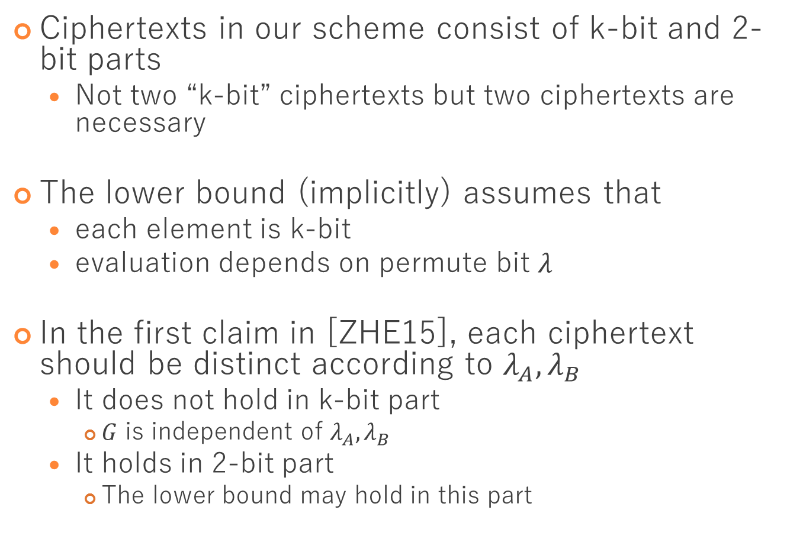
Why we can circumvent the lower bound
Ciphertexts in our scheme consist of k-bit and 2-bit parts
  Not two “k-bit” ciphertexts but two ciphertexts are necessary
The lower bound (implicitly) assumes that
  each element is k-bit
  evaluation depends on permute bit $λ$
In the first claim in [ZHE15], each ciphertext should be distinct according to $λ_{A},λ_{B}$
  It does not hold in k-bit part
    $G$ is independent of $λ_{A},λ_{B}$
  It holds in 2-bit part
    The lower bound may hold in this part
Notes:
Finally, we briefly explain why we can circumvent the lower bound.
Zahur et al.
Evaluation does not depend on permute bit $λ$Our scheme

Slide 33
Identity gate
Input A | Input B | Output
0 | 0 | 0
0 | 1 | 1
1 | 0 | 0
1 | 1 | 1
Input A | Input B | Output
0 | 0 | 0
0 | 1 | 0
1 | 0 | 1
1 | 1 | 0

Slide 34









Strategy of evaluation
Hash the input keys in each gate
  For input $K_{a}^{A}$, $K_{b}^{B}$, and $a,b∈\left\{0,1\right\}$, evaluator computes $H(K_{a}^{A}⊙K_{b}^{B})$ for some $⊙$
$$K_{a}^{A}$$
$$K_{b}^{B}$$
Evaluation:
1. Compute $H(K_{a}^{A}⊙K_{b}^{B})$
.
.
.
.
.
Fin. Output $K_{a∧b}^{C}$
$$G$$
$$H(K_{0}^{A}⊙K_{0}^{B})$$
$$H(K_{0}^{A}⊙K_{1}^{B})$$
$$H(K_{1}^{A}⊙K_{0}^{B})$$
$$H(K_{1}^{A}⊙K_{1}^{B})$$
$$K_{a∧b}^{C}$$
$$K_{0}^{C}$$
$$K_{1}^{C}$$

Slide 35





Requirement of $⊙$
$H\left(K_{1}^{A}⊙K_{1}^{B}\right)≠H\left(K_{a}^{A}⊙K_{b}^{B}\right)$, where $(a,b)≠(1,1)$
Two of $H\left(K_{0}⊙K_{0}\right), H\left(K_{0}⊙K_{1}\right), H(K_{1}⊙K_{0})$ are the same
$$K_{a}^{A}$$
$$K_{b}^{B}$$
Procedure:
1. Compute $H(K_{a}^{A}⊙K_{b}^{B})$
Fin. output $K_{a∧b}^{C}$
$$G$$
$$H(K_{0}^{A}⊙K_{0}^{B})$$
$$H(K_{0}^{A}⊙K_{1}^{B})$$
$$H(K_{1}^{A}⊙K_{0}^{B})$$
$$H(K_{1}^{A}⊙K_{1}^{B})$$
$$K_{a∧b}^{C}$$

Slide 36
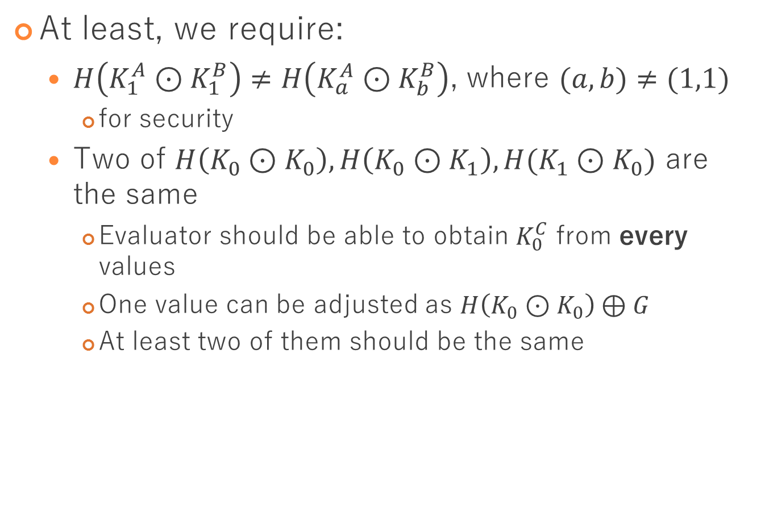
Garbling AND gate with one ciphertext
At least, we require:
  $H\left(K_{1}^{A}⊙K_{1}^{B}\right)≠H\left(K_{a}^{A}⊙K_{b}^{B}\right)$, where $(a,b)≠(1,1)$
    for security
  Two of $H\left(K_{0}⊙K_{0}\right), H\left(K_{0}⊙K_{1}\right), H(K_{1}⊙K_{0})$ are the same
    Evaluator should be able to obtain $K_{0}^{C}$ from every values
    One value can be adjusted as $H\left(K_{0}⊙K_{0}\right)⊕G$
    At least two of them should be the same

Slide 37
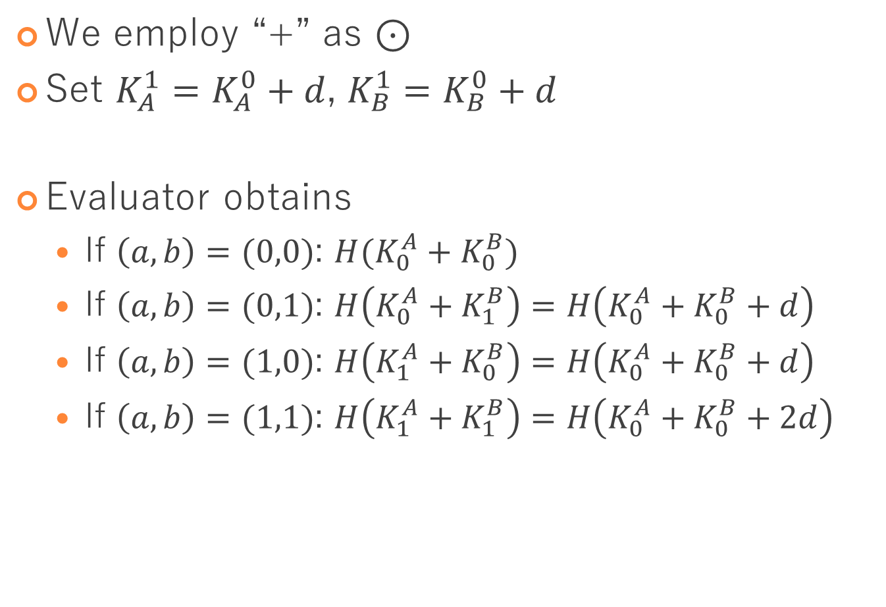
Intuition: Garbling AND with one ciph.
We employ “+” as $⊙$
Set $K_{A}^{1}=K_{A}^{0}+d$, $K_{B}^{1}=K_{B}^{0}+d$
Evaluator obtains
  If $\left(a,b\right)=(0,0)$: $H(K_{0}^{A}+K_{0}^{B})$
  If $\left(a,b\right)=(0,1)$: $H\left(K_{0}^{A}+K_{1}^{B}\right)=H\left(K_{0}^{A}+K_{0}^{B}+d\right)$
  If $\left(a,b\right)=(1,0)$: $H\left(K_{1}^{A}+K_{0}^{B}\right)=H\left(K_{0}^{A}+K_{0}^{B}+d\right)$
  If $\left(a,b\right)=(1,1)$: $H\left(K_{1}^{A}+K_{1}^{B}\right)=H\left(K_{0}^{A}+K_{0}^{B}+2d\right)$

Slide 38
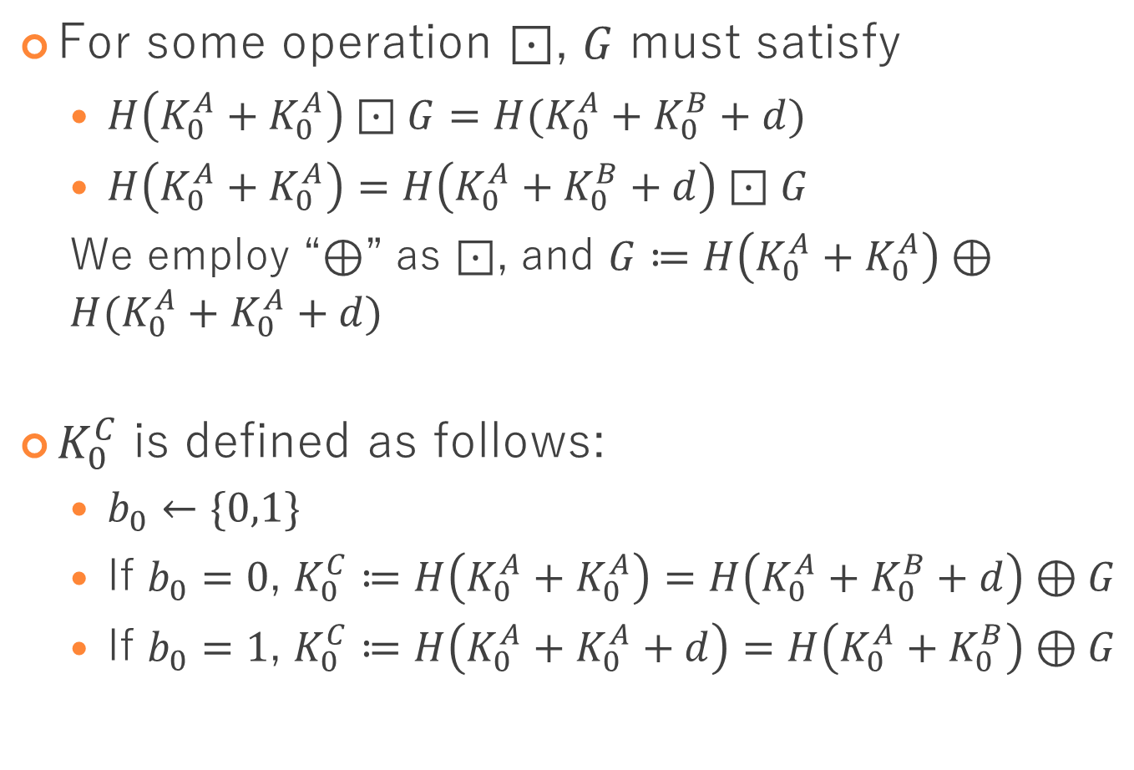

Define $K_{0}^{C}$ by $G$
For some operation $⊡$, $G$ must satisfy
  $H\left(K_{0}^{A}+K_{0}^{A}\right)⊡G=H(K_{0}^{A}+K_{0}^{B}+d)$
  $H\left(K_{0}^{A}+K_{0}^{A}\right)=H\left(K_{0}^{A}+K_{0}^{B}+d\right)⊡G$
  We employ “$⊕$” as $⊡$, and $G≔H\left(K_{0}^{A}+K_{0}^{A}\right)⊕H(K_{0}^{A}+K_{0}^{A}+d)$
$K_{0}^{C}$ is defined as follows:
  $b_{0}←\{0,1\}$
  If $b_{0}=0$, $K_{0}^{C}≔H\left(K_{0}^{A}+K_{0}^{A}\right)=H\left(K_{0}^{A}+K_{0}^{B}+d\right)⊕G$
  If $b_{0}=1$, $K_{0}^{C}≔H\left(K_{0}^{A}+K_{0}^{A}+d\right)=H\left(K_{0}^{A}+K_{0}^{B}\right)⊕G$

Slide 39
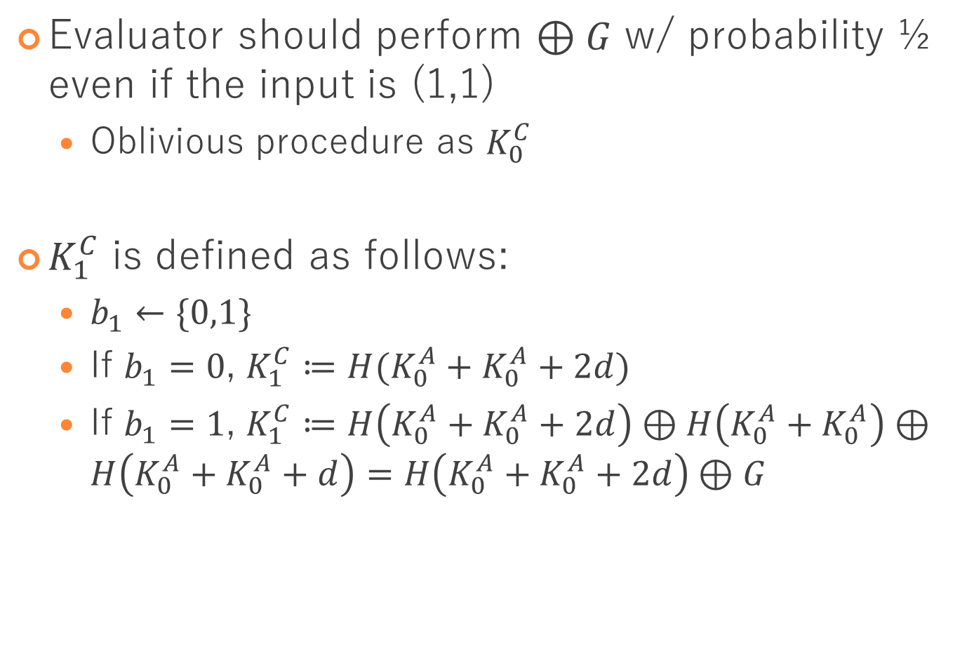

Define $K_{1}^{C}$
Evaluator should perform $⊕G$ w/ probability ½ even if the input is (1,1)
  Oblivious procedure as $K_{0}^{C}$
$K_{1}^{C}$ is defined as follows:
  $b_{1}←\{0,1\}$
  If $b_{1}=0$, $K_{1}^{C}≔H(K_{0}^{A}+K_{0}^{A}+2d)$
  If $b_{1}=1$, $K_{1}^{C}≔H\left(K_{0}^{A}+K_{0}^{A}+2d\right)⊕H\left(K_{0}^{A}+K_{0}^{A}\right)⊕H\left(K_{0}^{A}+K_{0}^{A}+d\right)=H\left(K_{0}^{A}+K_{0}^{A}+2d\right)⊕G$

Slide 40

Garbling input XOR gate
$Δ_{a}≔K_{0}^{A}⊕K_{1}^{A}$
Choose $K_{0}^{B},K_{1}^{B}$ as $K_{0}^{B}⊕K_{1}^{B}=Δ_{a}$
Use free-XOR technique
requires no ciphertext

Slide 41

Garbling mid XOR gate
$Δ_{a}≔K_{0}^{A}⊕K_{1}^{A}$
Adjust $K_{λ_{B}}^{B^{′}}$ s.t. $K_{λ_{B}}^{B^{′}}⊕K_{1−λ_{B}}^{B}=Δ_{a}$
Use free-XOR technique
requires 1 k-bit ciphertext per XOR gate

Slide 42
Summary
Zahur et al. [ZRE15] showed the lower bound
  In linear garbling scheme, garbled AND gate contains at least two k-bit ciphertexts
We show a “linear” garbling scheme
  circumvents
  Garbled AND gate contains less than two k-bit ciphertexts
  It does not contradict but rather circumvents the lower bound
Notes:
First, I’d like to explain the summary of result.
At EUROCRYPT 2015, Zahur, Rosulek, and Evans claimed that
In any linear, and thus efficient, garbling scheme, garbled AND gate contains at least two k-bit ciphertexts.
So, this is the lower bound of the size of garbled circuit.
In this paper, we propose a linear garbling scheme in which garbled AND gate contains less than two k-bit ciphertexts.
You may think that it contradicts the lower bound.
However, it actually does not contradict but rather circumvents the bound.

Slide 43



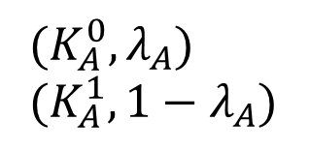


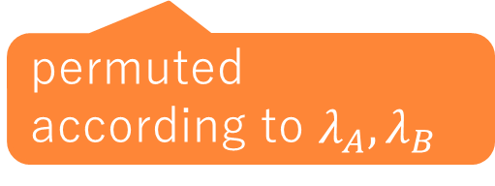
Encrypt $b_{0}$ and $b_{1}$
Similar to classical garbling scheme
  Additionally contain four 2-bit ciphertexts
  The order of the ciphertexts should be permuted by permute bit $λ←\left\{0,1\right\}$
$(K_{A}^{0},λ_{A})$
$(K_{A}^{1},1−λ_{A})$
$G$
$H_{2}\left(K_{A}^{0}||K_{B}^{0}\right)⊕\left(λ_{C}||b_{0}\right)$
$H_{2}\left(K_{A}^{0}||K_{B}^{1}\right)⊕\left(λ_{C}||(1−b_{0}\right))$
$H_{2}\left(K_{A}^{1}||K_{B}^{0}\right)⊕\left(λ_{C}||(1−b_{0})\right)$
$H_{2}\left(K_{A}^{1}||K_{B}^{1}\right)⊕\left(1−λ_{C}||b_{1}\right)$
$(K_{C}^{0},λ_{C})$
$(K_{C}^{1},1−λ_{C})$
$(K_{B}^{0},λ_{B})$
$(K_{B}^{1},1−λ_{B})$
permuted
according to $λ_{A},λ_{B}$
Notes:
We have shown garbling scheme except b_0 and b_1.
We encrypt b_0 and b_1 as classical garbling scheme with permutation.
Namely, we add four ciphertexts that are 2 bit.
For security reason,
the order of the ciphertexts should be permuted so we add permute bit $λ$ in addition to the keys.
Input is the keys and permute bit,
and garbled gate contains G and four 2-bit ciphertexts, and the output is the key and next permute bit.

