Slide 1
Reactive Garbling Schemes
Jesper Buus Nielsen and Samuel Ranellucci

Slide 2
Result
Define reactive garbling scheme (RGS)
Reactive 2PC protocol from RGS
Black-box
malicious adversary
Construction of reactive garbling scheme
Random oracle

Slide 3
Reactive computation
Initialization
$S_{1}←0$ (state)
$i ← 1$ (round)
At round i
$$P_{1}$$
$P_{2}$
Reactive 2PC
$$f,x$$
$$y$$
$$(z,v)←f(x,y,S_{i})$$
$$S_{i+1}←v || S_{i}$$
$$z,f$$
$$i←i+1$$

Slide 4
Garbling scheme (GS)
What do garbling scheme achieve?
Garbling scheme, defined by [BHR12], formalise what Yao’s garbled circuits achieve.
Why define garbling scheme?
Protocol that use a primitive in a black-box fashion are easier to prove secure and are less prone to errors.
The underlying primitive can be instantiated with different protocols without redoing proof of security.

Slide 5
Applications of garbling scheme
Secure outsourcing
Secure computation
Private function evaluation
….

Slide 6
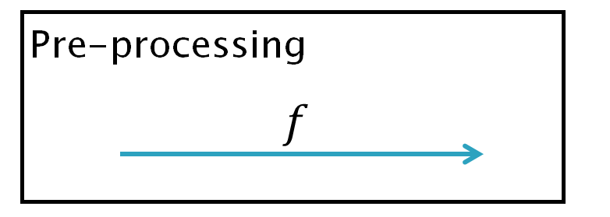
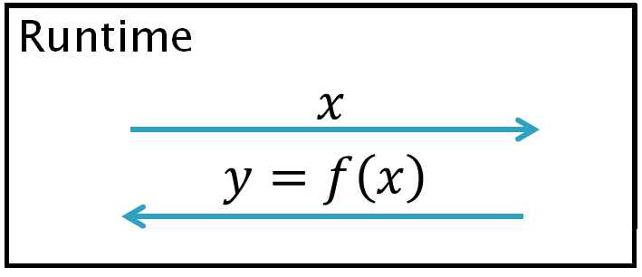
Insecure garbling scheme
Sender
Receiver

Slide 7
Security definition
Correctness
output $y = f\left(x\right)$
Privacy
Hide $(f,x)$from the receiver
Obliviousness
Hide $(f,x,y)$from the receiver

Slide 8
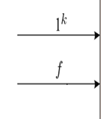
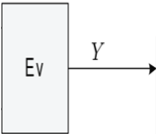
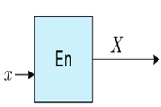
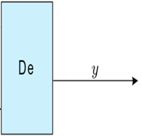
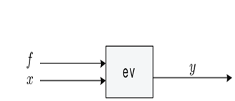
Global view of garbling scheme
Step 4: extract output
Step 2: encode the input
Step 3: blind evaluation
Step 1: garble the function

Slide 9
What can RGS do that GS can’t?
Partial input/output
Assemble garbled functions together
Black-box construction of 2PC
Reuse encoded output

Slide 10
GS to RGS
Vectorize
Output encoding string
Tags
Linking algorithm
Confidentiality

Slide 11
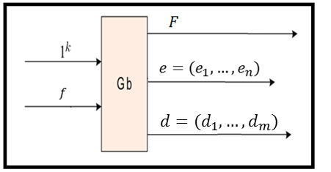
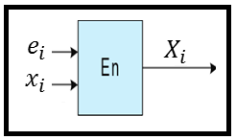
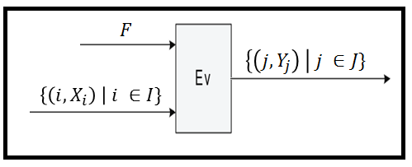
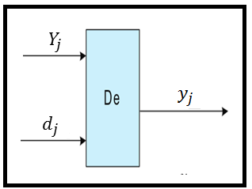
Vectorised garbling scheme

Slide 12
Output encoding string
Maps an output value to an encoded output
Used to link two garbling

Slide 13
Linking algorithm
Input
output encoding string
input encoding string
Output (Linking information)
Converter: encoded output $→$ encoded input

Slide 14
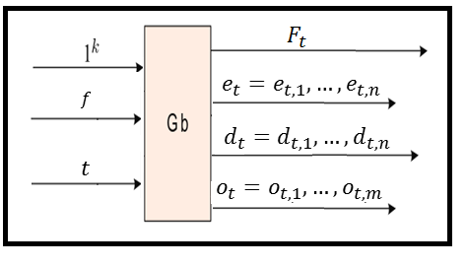
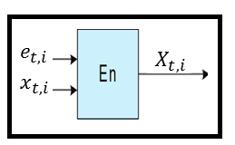
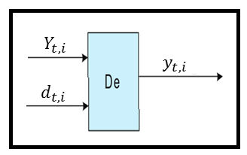
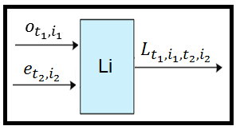
Reactive garbling scheme

Slide 15
Evaluation procedure
Input
$ℱ$ set of garbled functions
$𝒳$ set of garbled inputs
$ℒ$ set of linking information
Output:
$𝒴$ encoded output

Slide 16
Confidentiality
Obliviousness: $(F,X)$hides $(f,x,y)$.
Privacy: $(F,X,d)$hides $(f,x)$
Confidentiality
$y_{i}$ is hidden unless you have $d_{i}$
$(f,x)$ is hidden
Confidentiality $⇒$Obliviousness and Privacy

Slide 17
Toy example
Garble $f$
Garble $g$
Link $G$ to $F$
Provide encoded input
Decode output
$$0$$
$$f$$
$$f$$
$$g$$
$$g$$
$$1$$
$$0$$
$$0$$

Slide 18
Applications
Reactive two-party computation
Black-box
Watchlist
Lindell’s cheater detection
Black-box
Minilego as a RGS

Slide 19
Realizing reactive 2PC
Watchlist setup
Garble many circuits
Use half of circuits to verify that $P_{1}$ is honest
Evaluate other-half in parallel to learn output
Main security issues
Input consistency of $P_{1}$
Selective failure problem

Slide 20
Enforcing input consistency
v$\left(\left(x,k\right),g\right)≔(x,g\left(x\right)⊕k$)
$g$ is 2-universal
$x≠x^{′}⇒$
$g\left(x\right)⊕k≠g\left(x^{′}\right)⊕k′$
$$P_{1}$$
$$P_{2}$$
$$f$$
$$X$$
$$v$$
$$g\left(x\right)⊕k$$
$$x,k$$
g

Slide 21
Preventing selective failure attacks
$$P_{1}$$
$$P_{2}$$
Garble identity function
Random input
Privacy amplifcation
$h\left(y^{′}\right)=y$
Linking
$id⇒h$
$h⇒f$
$$f$$
$$Y$$
$$h$$
$$Y′$$
$$id$$
$$y′$$

Slide 22
Summary
We extend garbling schemes.
We can securely realize reactive 2PC from reactive garbling scheme
Black-box

Slide 23
Thank you for listening!

