Slide 1
When are
Fuzzy Extractors
Possible?
Benjamin Fuller Leonid Reyzin Adam Smith
U. Connecticut
Boston U.
Pennsylvania State U.
http://eprint.iacr.org/2014/961

Slide 2
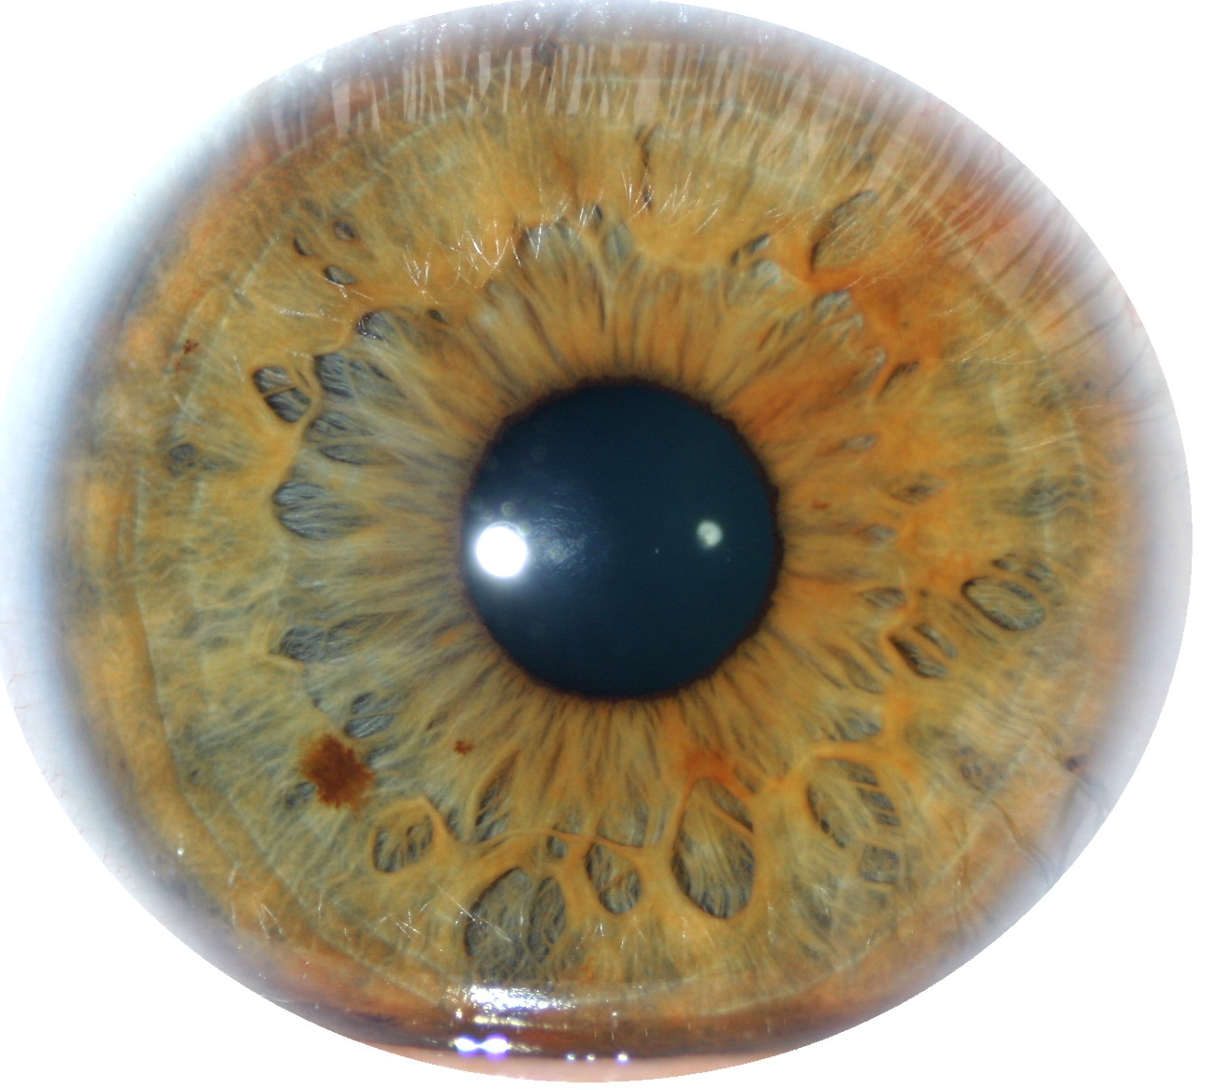
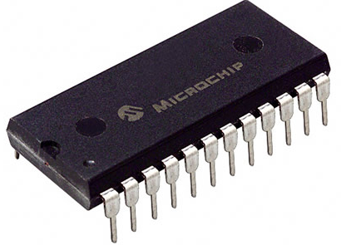
Key Derivation from Noisy Sources
Physically Unclonable Functions (PUFs)
Biometric Data
High-entropy sources are often noisy
  Initial reading w₀ ≠ later reading w₁
  Assume a bound on distance: d(w₀, w₁) ≤ t
Goal: derive a stable cryptographically strong output
  Want w₀, w₁ to map to same output
  The output should look uniform to the adversary
Why? Use output to bootstrap authentication
Notes:
http://sigma.octopart.com/14152599/image/Microchip-TC14433EPG.jpg
http://www.drgaelriverz.com/images/Round_Eye.JPG
E.g., self-enforcing, rather than server-enforced, authorization

Slide 3


Key Derivation from Noisy Sources
Alice
Bob
Non-Tampering Eve
w₁
w₀
Parties agree on cryptographic key
[Wyner 75]…
[Bennett-Brassard-Robert 86]…
[Maurer 93]…

Slide 4
Notation
Enrollment algorithm Gen (Alice):
Take a measurement w₀ from the source W.
Produce random key r and nonsecret value p.
Subsequent algorithm Rep (Bob):
give same output if d(w₀, w₁) < t
correctness
security
Gen
looks uniform given p
if the source is good enough
r
w₀
Rep
p
r
< t
w₁

Slide 5
When are fuzzy extractors possible?
Gen
looks uniform given p
if the source is good enough
r
w₀
Rep
p
r
< t
w₁

Slide 6
When are fuzzy extractors possible?
An adversary can always try a guess w₀ in W
p
r
Rep
Source W
Minimum requirement: every w₀ has low probability
Gen
looks uniform given p
if the source is good enough
r
w₀
Rep
p
r
= seed

Slide 7
When are fuzzy extractors possible?
Define min-entropy: H∞(W) = −log max Pr[w]
Necessary: H∞(W) > security parameter
And sufficient by Leftover Hash Lemma:
universal hash functions are extractors w/
long seed and entropy loss prop. to security param.
Minimum requirement: every w₀ has low probability
Gen
looks uniform given p
if the source is good enough
r
w₀
Rep
p
r
= seed

Slide 8
When are fuzzy extractors possible?
An adversary can always try a guess w₁ near many w₀
p
t
w₁
Rep
r
Source W
Minimum requirement: every B_{t} has low probability
Gen
looks uniform given p
if the source is good enough
r
w₀
Rep
p
r
< t
w₁

Slide 9
When are fuzzy extractors possible?
Define fuzzy min-entropy: H_{fuzz}(W) = −log max Pr[W ∈ B_{t}]
B_{t}
Minimum requirement: every B_{t} has low probability
Gen
looks uniform given p
if the source is good enough
r
w₀
Rep
p
r
< t
w₁

Slide 10
When are fuzzy extractors possible?
Define fuzzy min-entropy: H_{fuzz}(W) = −log max Pr[W ∈ B_{t}]
B_{t}
Why bother with this new notion? Can’t we use the old one?
H_{fuzz}(W) ≥ H∞(W) − log |B_{t}|
Because there are distributions
“with more errors than entropy”
( log |B_{t}| > H∞(W) )
But perhaps H_{fuzz}(W) > 0
Notes:
There are distributions that occur in practice that fuzzy extractors provide no security for. This is because they often use this kind of bound which is what comes from coding theory. Would adding Gaussian noise fix this?

Slide 11
Why is H_{fuzz} the right notion?
An adversary can always try a guess w₁ near many w₀
p
t
w₁
H_{fuzz}(W) necessary
Rep
r
Q: can we make sure that’s all the adversary can do?
A: yes, using obfuscation! [Bitansky Canetti Kalai Paneth 14]
Gen
r
Pick random r
p = obfuscate
{
if dis(w₀, ⋅ ) ≤ t → r
else → ⊥
}
w₀
Rep
p
r
Send input to the obfuscated program p
w₁

Slide 12
Why is H_{fuzz} the right notion?
An adversary can always try a guess w₁ near many w₀
p
t
w₁
Rep
r
H_{fuzz} is necessary
H_{fuzz} is sufficient against computational adversaries
What about information-theoretic adversaries?
Our Contribution:
Sufficient if the distribution is completely known
Insufficient in the case of distributional uncertainty
(several variants of this theorem)
Focus of the Talk
Notes:
Only consider Hamming distance.

Slide 13
Common design goal: one construction for family of sources
(e.g., all sources of a given H_{fuzz})
Why?
we may not know our source precisely
something about our source may have leaked out to Eve
or want a computationally efficient construction

Slide 14
How are fuzzy extractors built?
Ext converts entropy to almost uniform
(privacy amplification)
Gen
r
H_{fuzz}(w₀)=k
w₀
Ext
Notes:
If you haven’t heard the terms privacy amplification and information reconciliation don’t worry about it. They are just what is listed here.
As a warm up we’re going to look at the way that the vast majority of fuzzy extractors are built. We’ll prove impossibility of this approach and then use similar techniques for our other results.

Slide 15
How are fuzzy extractors built?
Ext converts entropy to almost uniform
(privacy amplification)
Sketch, Rec, known as secure sketch, corrects errors
(information reconciliation)
Gen
r
H_{fuzz}(w₀)=k
w₀
Ext
Rep
p
r
w₀
< t
Sketch
Ext
Rec
w₁

Slide 16
How can a sketch work for a family?
correctness
w₀
p
Rec
w₀
w₁

Slide 17
How can a sketch work for a family?
correctness
w₀
p
Rec
w₀
w₁

Slide 18
How can a sketch work for a family?
Rec needs to recover from w₁
regardless of which W
the original w₀ came from
correctness
w₀
p
Rec
w₀
w₁

Slide 19
How can a sketch work for a family?
Rec needs to recover from w₁
regardless of which W
the original w₀ came from
chooses points s.t. Rec
provides same value for
all nearby points
w₀
security
p
Rec
w₀
w₁

Slide 20
How can a sketch work for a family?
Rec needs to recover from w₁
regardless of which W
the original w₀ came from
chooses points s.t. Rec
provides same value for
all nearby points
w₀
security
p
Rec
w₀
w₁

Slide 21
How can a sketch work for a family?
Rec needs to recover from w₁
regardless of which W
the original w₀ came from
chooses points s.t. Rec
provides same value for
all nearby points
Few points from each
distribution will be at
center of a ball
w₀
security
p
Rec
w₀
w₁
Notes:
Slow down and talk about why these balls would exist

Slide 22
How can a sketch work for a family?
Rec needs to recover from w₁
regardless of which W
the original w₀ came from
chooses points s.t. Rec
provides same value for
all nearby points
Few points from each
distribution will be at
center of a ball
Theorem:
∃ family {W}
with linear H_{fuzz}(W)
s.t. any Sketch, Rec
handling linear error rate
with good probability
has H∞(W | p) < 2
Need family where each distribution has high H_{fuzz} and distributions share few points
p
Rec
w₀
w₁
Notes:
Write the number as a small constant and then say its actually 2

Slide 23
But we don’t need a sketch!
We don’t have to recover w₀!

Slide 24
But we don’t need a sketch!
We don’t have to recover w₀!
Gen
r
w₀
Ext
Rep
p
r
w₀
< t
Sketch
Ext
Rec
w₁

Slide 25
But we don’t need a sketch!
We don’t have to recover w₀!
Gen
r
w₀
something
else entirely
Rep
p
r
< t
something
else entirely
w₁

Slide 26
Impossibility of fuzzy ext for a family
Given p, this partition is known
Nothing near the boundary can have been w₀ (else Rep wouldn’t be 100% correct)
w₁ s.t. Rep(w₁, p) = 0
w₀
p
w₁ s.t. Rep(w₁, p) = 1
Rep
r
w₁
(even just one bit)

Slide 27
Impossibility of fuzzy ext for this family
Given p, this partition is known
Nothing near the boundary can have been w₀ (else Rep wouldn’t be 100% correct)
w₁ s.t. Rep(w₁, p) = 0
Leaves little uncertainty
about w₀ (high-dimensions ⇒
everything near boundary)
No w₀ in here!
correctness
Combined with Eve’s
knowledge of the
distribution it reveals
everything about w₀
w₁ s.t. Rep(w₁, p) = 1

Slide 28
Impossibility of fuzzy ext for this family
Given p, this partition is known
Nothing near the boundary can have been w₀ (else Rep wouldn’t be 100% correct)
Theorem:
∃ family {W}
with linear H_{fuzz}(W)
s.t. any Gen, Rep
handling a linear error rate
can’t extract even 3 bits
(if Rep is 100% correct)
Leaves little uncertainty
about w₀ (high-dimensions ⇒
everything near boundary)
Combined with Eve’s
knowledge of the
distribution it reveals
everything about w₀

Slide 29
Alternative family
Use [Holenstein-Renner 05]
result on impossibility of
key agreement from
bit-fixing sources
Theorem:
∃ family {W}
with linear H_{fuzz}(W)
s.t. any Gen, Rep
handling a linear error rate
can’t extract even 3 bits
(if Rep is 100% correct)
Obtain similar result, but
  + 100% correctness not required
  Parameters hidden by “linear”
  are worse

Slide 30
Summary
Natural and nec. notion: H_{fuzz}(W) = −log max Pr[W ∈ B_{t}]
Sufficient w/ comp. sec.
Sufficient if dist. known
t
w₁
r
Insufficient in case of
distributional uncertainty
for info.-theory construction
(several variants of
“insufficiency theorem”)
Rep
Q: can we provide computational sec. w/ weaker assump.?

